Slide 1

Exploratory analysis of Big Data and Cloud
Introduction to the Lab

Slide 2
Outline
Lab Topics
Lab Objectives
Learning Outcomes
Assessment
The project

Slide 3
Lab Topics
Introduction to Big data
Data models
Big data cloud environments
Docker for Big Data
Data Ingestion
NoSQL databases
Data analysis and visualization with Power BI
Using cloud environments for bi data analysis (Azure, AWS, GCP)

Slide 4

Lab Objectives
Understand big data concepts and tools.
Explore and utilize major cloud platforms (AWS, Azure, Google Cloud Platform).
Perform data ingestion and implement data storage solutions.
Conduct effective exploratory data analysis (EDA).
Visualize data and communicate insights to stakeholders.
Analyze real-world case studies.
Develop and present a comprehensive final project.

Slide 5

Learning Outcomes
By the end of the course, students will be able to:
Describe key big data concepts and challenges.
Use cloud platforms for big data processing and storage.
Implement data ingestion techniques and data warehousing solutions.
Perform exploratory data analysis to uncover insights.
Create and interpret data visualizations effectively.
Solve real-world problems using big data and cloud technologies.
Successfully develop and present a final project showcasing data analysis and cloud utilization skills.

Slide 6

Assessment
Labs hands-on: 20% (students must attend at least 75% of classes)
Final Project: 40% (details later)
Final Exam: 40% (pass / fail exam)

Slide 7
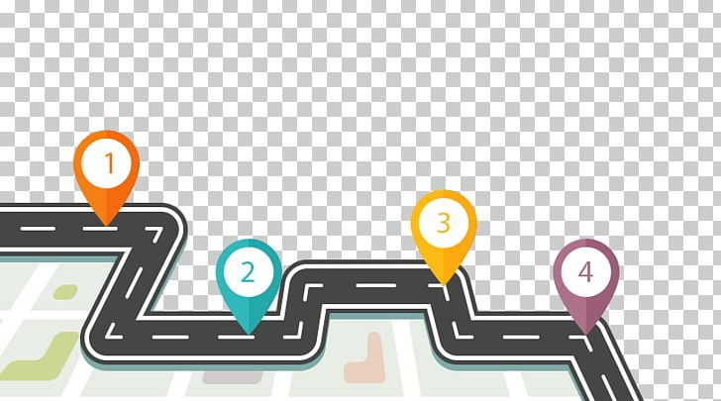
Project Road Map
Get the data:
Pick a dataset of your choice (must has big data characteristics “3Vs”)
Or collect by yourself various data from different sources
simple example: get world happiness indicator data for some countries, and social media posts for those countries to be analyzed.
Ingest and store your data
clean your data
Apply Exploratory Data analysis (EDA) on your data
uncover insights from your data and present results

Slide 8

Questions

